Slide 1
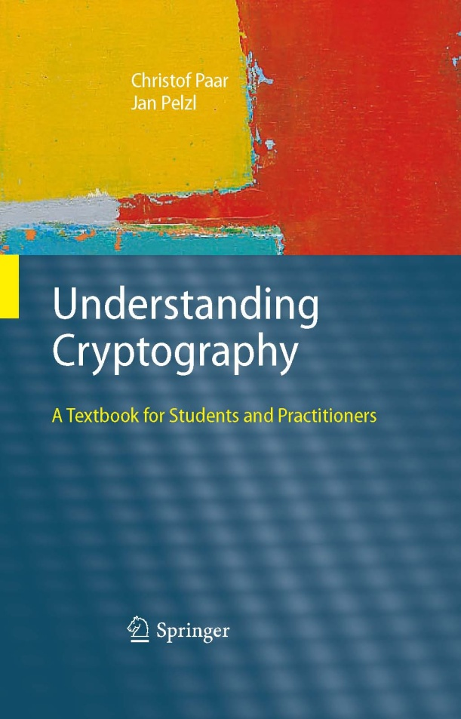
Understanding Cryptography – A Textbook for Students and Practitioners by Christof Paar and Jan Pelzl www.crypto-textbook.com
Chapter 10 – Digital Signatures ver. October 29, 2009
These slides were prepared by Georg Becker, Christof Paar and Jan Pelzl

Slide 2
Some legal stuff (sorry): Terms of Use
The slides can used free of charge. All copyrights for the slides remain with Christof Paar and Jan Pelzl.
The title of the accompanying book “Understanding Cryptography” by Springer and the author’s names must remain on each slide.
If the slides are modified, appropriate credits to the book authors and the book title must remain within the slides.
It is not permitted to reproduce parts or all of the slides in printed form whatsoever without written consent by the authors.
<number>/26
Chapter 10 of Understanding Cryptography by Christof Paar and Jan Pelzl

Slide 3
Content of this Chapter
The principle of digital signatures
Security services
The RSA digital signature scheme
The Digital Signature Algorithm (DSA)
<number>/26
Chapter 10 of Understanding Cryptography by Christof Paar and Jan Pelzl

Slide 4
Content of this Chapter
The principle of digital signatures
Security services
The RSA digital signature scheme
The Digital Signature Algorithm (DSA)
<number>/26
Chapter 10 of Understanding Cryptography by Christof Paar and Jan Pelzl

Slide 5
Motivation
Alice orders a pink car from the car salesmen Bob
After seeing the pink car, Alice states that she has never ordered it:
How can Bob prove towards a judge that Alice has ordered a pink car? (And that he did not fabricate the order himself)
Symmetric cryptography fails because both Alice and Bob can be malicious
Can be achieved with public-key cryptography
<number>/26
Chapter 10 of Understanding Cryptography by Christof Paar and Jan Pelzl

Slide 6
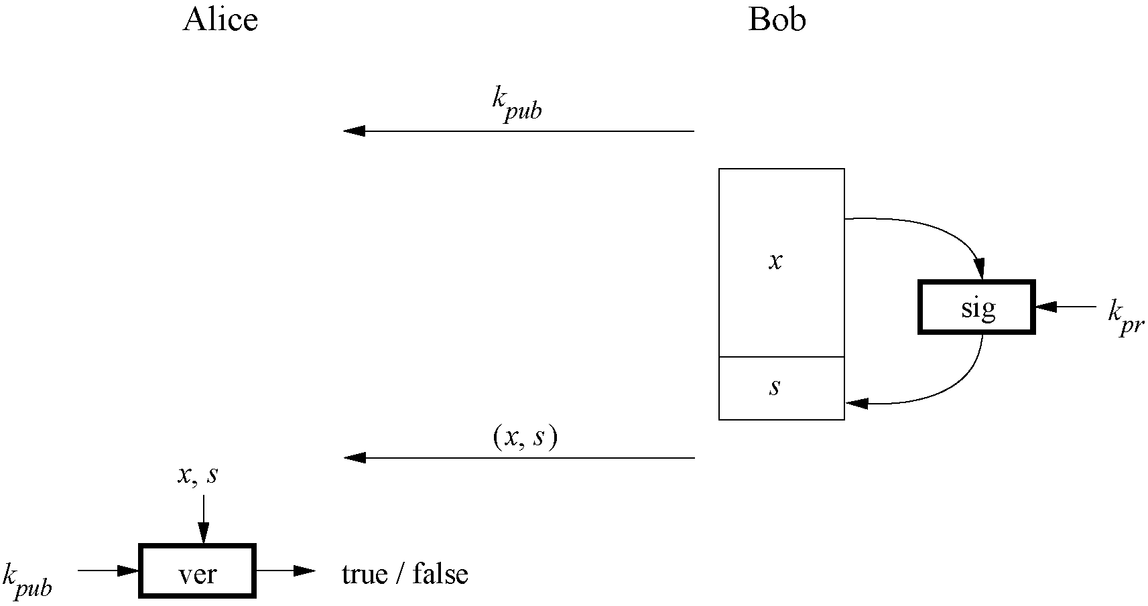
Basic Principle of Digital Signatures
<number>/26
Chapter 10 of Understanding Cryptography by Christof Paar and Jan Pelzl

Slide 7
Main idea
For a given message x, a digital signature is appended to the message (just like a conventional signature).
Only the person with the private key should be able to generate the signature.
The signature must change for every document.
The signature is realized as a function with the message x and the private key as input.
The public key and the message x are the inputs to the verification function.
<number>/26
Chapter 10 of Understanding Cryptography by Christof Paar and Jan Pelzl

Slide 8
Content of this Chapter
The principle of digital signatures
Security services
The RSA digital signature scheme
The Digital Signature Algorithm (DSA)
<number>/26
Chapter 10 of Understanding Cryptography by Christof Paar and Jan Pelzl

Slide 9
Core Security Services
The objectives of a security systems are called security services.
Confidentiality: Information is kept secret from all but authorized parties.
Integrity: Ensures that a message has not been modified in transit.
Message Authentication: Ensures that the sender of a message is authentic. An alternative term is data origin authentication.
Non-repudiation: Ensures that the sender of a message can not deny the creation of the message. (c.f. order of a pink car)
  Alice is the bad person now.
  Symmetric has the problem
<number>/26
Chapter 10 of Understanding Cryptography by Christof Paar and Jan Pelzl

Slide 10
Additional Security Services
Identification/entity authentication: Establishing and verification of the identity of an entity, e.g. a person, a computer, or a credit card.
Access control: Restricting access to the resources to privileged entities.
Availability: The electronic system is reliably available.
Auditing: Provides evidences about security relevant activities, e.g., by keeping logs about certain events.
Physical security: Providing protection against physical tampering and/or responses to physical tampering attempts
Anonymity: Providing protection against discovery and misuse of identity.
<number>/26
Chapter 10 of Understanding Cryptography by Christof Paar and Jan Pelzl

Slide 11
Content of this Chapter
The principle of digital signatures
Security services
The RSA digital signature scheme
The Digital Signature Algorithm (DSA)
<number>/26
Chapter 10 of Understanding Cryptography by Christof Paar and Jan Pelzl

Slide 12
Main idea of the RSA signature scheme
To generate the private and public key:
Use the same key generation as RSA encryption.
To generate the signature:
“encrypt” the message x with the private key
Append s to message x
To verify the signature:
“decrypt” the signature with the public key
If x=x’, the signature is valid
  s = sig_{Kpriv}(x) = x^{d} mod n
  x’=ver_{Kpub}(s)=s^{e} mod n
<number>/26
Chapter 10 of Understanding Cryptography by Christof Paar and Jan Pelzl

Slide 13
The RSA Signature Protocol
Alice
Bob
K_{pub}
K_{pr} = d
K_{pub} = (n, e)
Compute signature:
s = sig_{kpr}(x) ≡ x^{d} mod n
(x,s)
Verify signature:
x‘ ≡ s^{e} mod n
If x‘ ≡ x mod n → valid signature
If x‘ ≡ x mod n → invalid signature
<number>/26
Chapter 10 of Understanding Cryptography by Christof Paar and Jan Pelzl

Slide 14
Security and Performance of the RSA Signature Scheme
Security:
The same constrains as RSA encryption: n needs to be at least 1024 bits to provide a security level of 80 bit.
The signature, consisting of s, needs to be at least 1024 bits long
Performance:
The signing process is an exponentiation with the private key and the verification process an exponentiation with the public key e.
Signature verification is very efficient as a small number can be chosen for the public key.
<number>/26
Chapter 10 of Understanding Cryptography by Christof Paar and Jan Pelzl

Slide 15

Existential Forgery Attack against RSA Digital Signature
Alice
Oscar
Bob
K_{pr} = d
K_{pub} = (n, e)
(n,e)
(n,e)
1. Choose signature:
s Z_{n}
2. Compute message:
x ≡ s^{e} mod n
(x,s)
Verification:
s^{e} ≡ x‘ mod n
since s^{e} ≡ x mod n (Oscar did)
→ Signature is valid
<number>/26
Chapter 10 of Understanding Cryptography by Christof Paar and Jan Pelzl

Slide 16
Existential Forgery and Padding
An attacker can generate valid message-signature pairs (x,s)
But an attack can only choose the signature s and NOT the message x
Attacker cannot generate messages like „Transfer $1000 into Oscar‘s account“
Formatting the message x according to a padding scheme can be used to make sure that an attacker cannot generate valid (x,s) pairs.
(A messages x generated by an attacker during an Existential Forgery Attack will not coincide with the padding scheme. For more details see Chapter 10 in Understanding Cryptography.)
<number>/26
Chapter 10 of Understanding Cryptography by Christof Paar and Jan Pelzl

Slide 17
Content of this Chapter
The principle of digital signatures
Security services
The RSA digital signature scheme
The Digital Signature Algorithm (DSA)
<number>/26
Chapter 10 of Understanding Cryptography by Christof Paar and Jan Pelzl

Slide 18
ElGamal signature scheme
Is a digital signature scheme
  based on the difficulty of computing discrete logarithms.
It was described by Taher ElGamal in 1984.
The ElGamal signature algorithm is rarely used in practice.
  A variant developed at NSA and known as the Digital Signature Algorithm is much more widely used.
There are several other variants.
<number>/34
Chapter 10 of Understanding Cryptography by Christof Paar and Jan Pelzl

Slide 19
Facts about the Digital Signature Algorithm (DSA)
Federal US Government standard for digital signatures (DSS)
Proposed by the National Institute of Standards and Technology (NIST)
DSA is based on the Elgamal signature scheme
Signature is only 320 bits long
Signature verification is slower compared to RSA
18/26
Chapter 10 of Understanding Cryptography by Christof Paar and Jan Pelzl

Slide 20
The Digital Signature Algorithm (DSA)
Key generation of DSA:
Generate a prime p with 2¹⁰²³ < p < 2¹⁰²⁴
Find a prime divisor q of p-1 with 2¹⁵⁹ < q < 2¹⁶⁰
Find an integer α with ord(α)=q
Choose a random integer d with 0<d<q
Compute β ≡ α^{d} mod p
The keys are:
k_{pub} = (p,q,α,β)
k_{pr} = (d)
<number>/26
Chapter 10 of Understanding Cryptography by Christof Paar and Jan Pelzl

Slide 21
The Digital Signature Algorithm (DSA)
DSA signature generation :
Given: message x, signature s, private key d and public key (p,q,α,β)
Choose an integer as random ephemeral key k_{E} with 0<k_{E}<q
Compute r ≡ (α^{kE} mod p) mod q
Computes s ≡ (SHA(x)+d ∙ r) k_{E}⁻¹ mod q
The signature consists of (r,s)
SHA denotes the hashfunction SHA-1 which computes a 160-bit fingerprint of message x. (See Chapter 11 of Understanding Cryptography for more details)
<number>/26
Chapter 10 of Understanding Cryptography by Christof Paar and Jan Pelzl

Slide 22
The Digital Signature Algorithm (DSA)
DSA signature verification
Given: message x, signature s and public key (p,q,α,β)
Compute auxiliary value w ≡ s⁻¹ mod q
Compute auxiliary value u₁ ≡ w ∙ SHA(x) mod q
Compute auxiliary value u₂ ≡ w ∙ r mod q
Compute v ≡ (α^{u1} ∙ β ^{u2} mod p) mod q
If v ≡ r mod q → signature is valid
If v ≡ r mod q → signature is invalid
<number>/26
Chapter 10 of Understanding Cryptography by Christof Paar and Jan Pelzl

Slide 23
Proof of DSA:
We show need to show that the signature (r,s) in fact satisfied the condition r ≡ v mod q:
  s ≡ (SHA(x))+d ∙r) ∙ k_{E} ⁻¹ mod q
⬄ k_{E} ≡ s⁻¹ SHA(x) + d ∙ s⁻¹ r mod q
⬄ k_{E} ≡u₁+d ∙ u₂ mod q
We can raise α to either side of the equation if we reduce modulo p:
⬄ α^{kE} mod p ≡ α^{u1+d∙u2} mod p
Since β ≡ α^{d} mod p we can write:
⬄ α^{kE} mod p ≡ α^{u1} β^{u2} mod p
We now reduce both sides of the equation modulo q:
⬄ (α^{kE} mod p) mod q ≡ (α^{u1} β^{u2} mod p) mod q
Since r ≡ α^{kE} mod p mod q and v ≡ (α^{u1} β^{u2} mod p) mod q, this expression is identical to:
⬄ r ≡ v
<number>/26
Chapter 10 of Understanding Cryptography by Christof Paar and Jan Pelzl

Slide 24
Example
Alice
Bob
Key generation:
choose p = 59 and q = 29
choose α = 3
choose private key d = 7
β = α^{β} = 3⁷ ≡ 4 mod 59
Sign:
Compute has of message H(x)=26
Choose ephermal key k_{E}=10
r = (3¹⁰ mod 59) ≡ 20 mod 29
s = (26 + 7 ∙ 20) ∙ 3) ≡ 5 mod 29
(p, q, α, β)=(59, 29, 3, 4)
(x,(r, s))=(x,20, 5)
Verify:
w ≡ 5⁻¹ ≡ 6 mod 29
u₁ ≡ 6 ∙ 26 ≡ 11 mod 29
u₂ ≡ 6 ∙ 20 ≡ 4 mod 29
v = (3¹¹ ∙ 4⁴ mod 59) mod 29 = 20
v ≡ r mod 29 → valid signature
<number>/26
Chapter 10 of Understanding Cryptography by Christof Paar and Jan Pelzl

Slide 25
Security of DSA
To solve the discrete logarithm problem in p the powerful index calculus method can be applied. But this method cannot be applied to the discrete logarithm problem of the subgroup q. Therefore q can be smaller than p. For details see Chapter 10 and Chapter 8 of Understanding Cryptography .
p | q | hash output (min) | security levels
1024 | 160 | 160 | 80
2048 | 224 | 224 | 112
3072 | 256 | 256 | 128
Standardized parameter bit lengths and security levels for the DSA
<number>/26
Chapter 10 of Understanding Cryptography by Christof Paar and Jan Pelzl

Slide 26
Elliptic Curve Digital Signature Algorithm (ECDSA)
Based on Elliptic Curve Cryptography (ECC)
Bit lengths in the range of 160-256 bits can be chosen to provide security equivalent to 1024-3072 bit RSA (80-128 bit symmetric security level)
One signature consists of two points, hence the signature is twice the used bit length (i.e., 320-512 bits for 80-128 bit security level).
The shorter bit length of ECDSA often result in shorter processing time
For more details see Section 10.5 in Understanding Cryptography
<number>/26
Chapter 10 of Understanding Cryptography by Christof Paar and Jan Pelzl

Slide 27
Lessons Learned
Digital signatures provide message integrity, message authentication and non-repudiation.
RSA is currently the most widely used digital signature algorithm.
Competitors are the Digital Signature Standard (DSA) and the Elliptic Curve Digital Signature Standard (ECDSA).
RSA verification can be done with short public keys e. Hence, in practice, RSA verification is usually faster than signing.
DSA and ECDSA have shorter signatures than RSA
In order to prevent certain attacks, RSA should be used with padding.
The modulus of DSA and the RSA signature schemes should be at least 1024- bits long. For true long-term security, a modulus of length 3072 bits should be chosen. In contrast, ECDSA achieves the same security levels with bit lengths in the range 160–256 bits.
<number>/26
Chapter 10 of Understanding Cryptography by Christof Paar and Jan Pelzl

